Slide 1

DECISION TREES
Introduction

Slide 2
Classification
The goal of classification is to build a model based on
the training data
    Supervised learning technique
Constructed by analyzing database samples
Once such a predictive model is built
    It can be used to predict the class of the objects of test cases
Two sets of data in classification task
    Training data, used to build the classification model
    Test data, for which classes are not known

Slide 3
Classification—A Two-Step Process
Model construction: describing a set of predetermined classes
  Each tuple/sample is assumed to belong to a predefined class, as determined by the class label attribute
  The set of tuples used for model construction: training set
  The model is represented as classification rules, decision trees, or mathematical formulae
Model usage: for classifying future or unknown objects
  Estimate accuracy of the model
    The known label of test sample is compared with the classified result from the model
    Accuracy rate is the percentage of test set samples that are correctly classified by the model
    Test set is independent of training set, otherwise over-fitting will occur

Slide 4
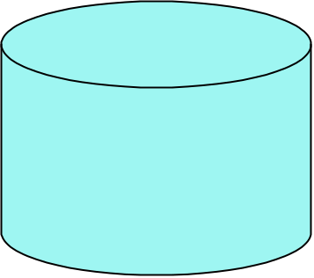
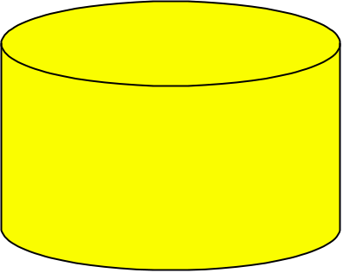

Classification Process (1): Model Construction
Classification
Algorithms
Training
Data
Classifier
(Model)
IF rank = ‘professor’
OR years > 6
THEN tenured = ‘yes’

Slide 5
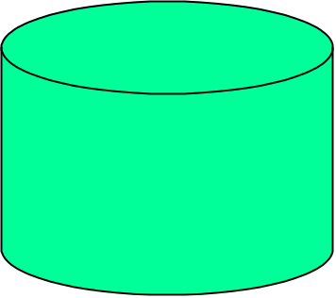



Classification Process (2): Use the Model in Prediction
Classifier
Testing
Data
Unseen Data
(Jeff, Professor, 4)
Tenured?

Slide 6
Classification
  Types of classifiers
    Comprehensible classifiers (Rule based classifiers)
      Decision tree, Ripper, CN2 etc.
    Non-comprehensible classifiers (Statistical or mathematical classifiers)
      SVM, Naïve bayes, NN etc.
  The aims of the research in classification field is
    Find highly accurate learning models
    Easy to understand (Comprehensible)
    Efficient when dealing with large databases

Slide 7
Evaluating Classification Methods
Predictive accuracy
Speed and scalability
  time to construct the model
  time to use the model
Robustness
  handling noise and missing values
Scalability
  efficiency in disk-resident databases
Interpretability
  understanding and insight provided by the model

Slide 8
DECISION TREES
Introduction
It is a method that induces concepts from examples (inductive learning)
Most widely used & practical learning method
The learning is supervised: i.e. the classes or categories of the data instances are known
It represents concepts as decision trees (which can be rewritten as if-then rules)

Slide 9
DECISION TREES
Introduction
The target function can be Boolean or discrete valued

Slide 10
DECISION TREES
Decision Tree Representation
1. Each node corresponds to an attribute
2. Each branch corresponds to an attribute value
3. Each leaf node assigns a classification

Slide 11
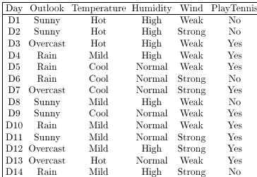
DECISION TREES
Example

Slide 12
DECISION TREES
Outlook
Example
Sunny
Rain
Overcast
Humidity Wind
Yes
High
Normal
Strong
Weak
Yes
Yes
No
No
A Decision Tree for the concept PlayTennis
An unknown observation is classified by testing its attributes and reaching a leaf node

Slide 13
DECISION TREES
Decision Tree Representation
Decision trees represent a disjunction of conjunctions of constraints on the attribute values of instances
Each path from the tree root to a leaf corresponds to a conjunction of attribute tests (one rule for classification)
The tree itself corresponds to a disjunction of these conjunctions (set of rules for classification)

Slide 14
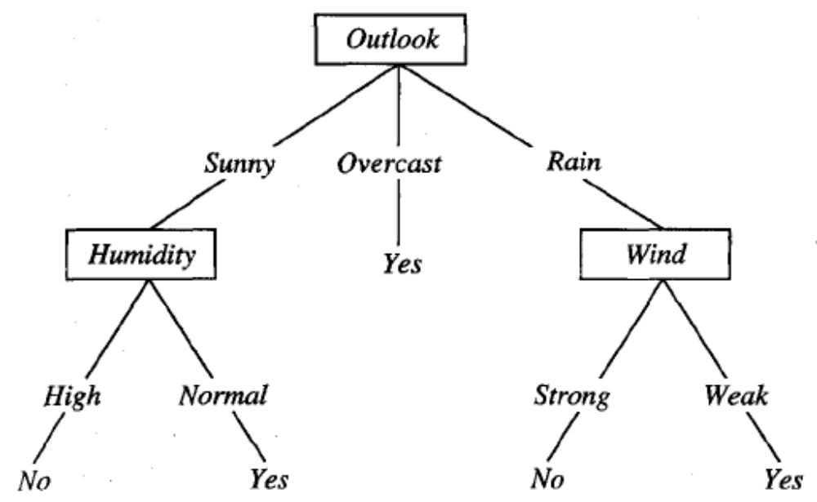
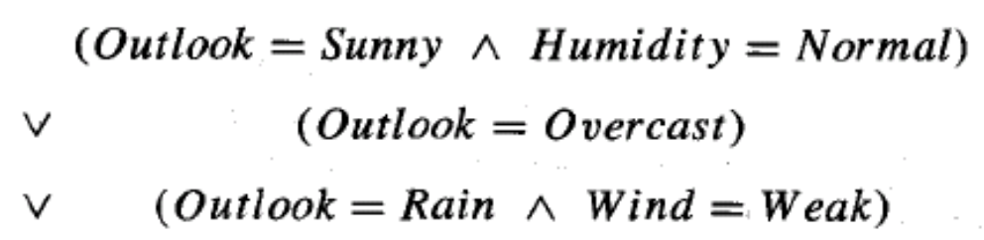
DECISION TREES
Decision Tree Representation

Slide 15
DECISION TREES
Basic Decision Tree Learning Algorithm

Slide 16
DECISION TREES
Basic Decision Tree Learning Algorithm
Most algorithms for growing decision trees are variants of a basic algorithm
An example of this core algorithm is the ID3 algorithm developed by Quinlan (1986)
It employs a top-down, greedy search through the space of possible decision trees

Slide 17
DECISION TREES
Basic Decision Tree Learning Algorithm
First of all we select the best attribute to be tested at the root of the tree
For making this selection each attribute is evaluated using a statistical test to determine how well it alone classifies the training examples
The selection process is then repeated using the training examples associated with each descendant node to select the best attribute to test at that point in the tree

Slide 18
DECISION TREES
Basic Decision Tree Learning Algorithm
This forms a greedy search for an acceptable decision tree, in which the algorithm never backtracks to reconsider earlier choices

Slide 19
DECISION TREES
Which Attribute is the Best Classifier?

Slide 20
DECISION TREES
Which Attribute is the Best Classifier?
The central choice in the ID3 algorithm is selecting which attribute to test at each node in the tree
We would like to select the attribute which is most useful for classifying examples
For this we need a good quantitative measure
For this purpose a statistical property, called information gain is used

Slide 21
DECISION TREES
Which Attribute is the Best Classifier?: Definition of Entropy
In order to define information gain precisely, we begin by defining entropy
Entropy is a measure commonly used in information theory.
Entropy characterizes the impurity of an arbitrary collection of examples

Slide 22

DECISION TREES
Which Attribute is the Best Classifier?: Definition of Entropy
This formula is called Entropy H
H(X) =
High Entropy means that the examples have almost equal probability of occurrence (and therefore not easily predictable)
Low Entropy means easy predictability

Slide 23
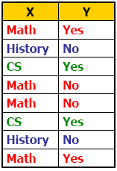
DECISION TREES
Which Attribute is the Best Classifier?: Information Gain
Suppose we are trying to predict output Y (Like Film Gladiator) & we have input X (College Major = v)
Major
Math
CS
History

Slide 24
DECISION TREES
Which Attribute is the Best Classifier?: Information Gain
We have H(Y) = 1.0
Conditional Entropy H(Y | X = v)
The Entropy of Y among only those records in which X = v
Major
Math
CS
History

Slide 25
DECISION TREES
Which Attribute is the Best Classifier?: Information Gain
Conditional Entropy of Y
H(Y | X = Math) = 1.0
H(Y | X = History) = 0
H(Y | X = CS) = 0
Major
Math
CS
History

Slide 26

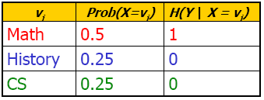
DECISION TREES
Which Attribute is the Best Classifier?: Information Gain
Average Conditional Entropy of Y
H(Y | X) =
Major
Math
CS
History

Slide 27
DECISION TREES
Which Attribute is the Best Classifier?: Information Gain
Let’s investigate the attribute Wind

Slide 28


DECISION TREES
Which Attribute is the Best Classifier?: Information Gain
The collection of examples has 9 positive values and 5 negative ones
Eight (6 positive and 2 negative ones) of these examples have the attribute value Wind = Weak
Six (3 positive and 3 negative ones) of these examples have the attribute value Wind = Strong

Slide 29
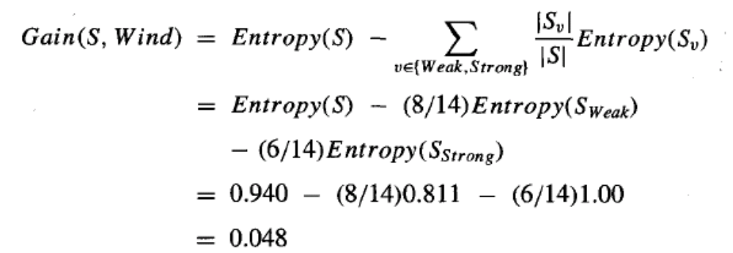
DECISION TREES
Which Attribute is the Best Classifier?: Information Gain
The information gain obtained by separating the examples according to the attribute Wind is calculated as:

Slide 30
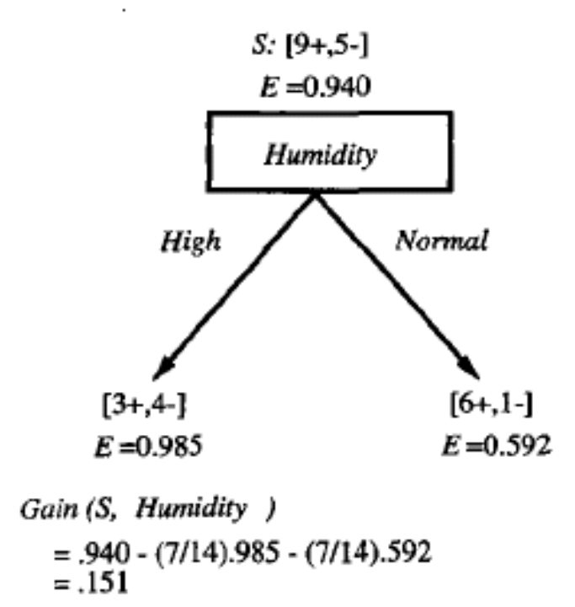
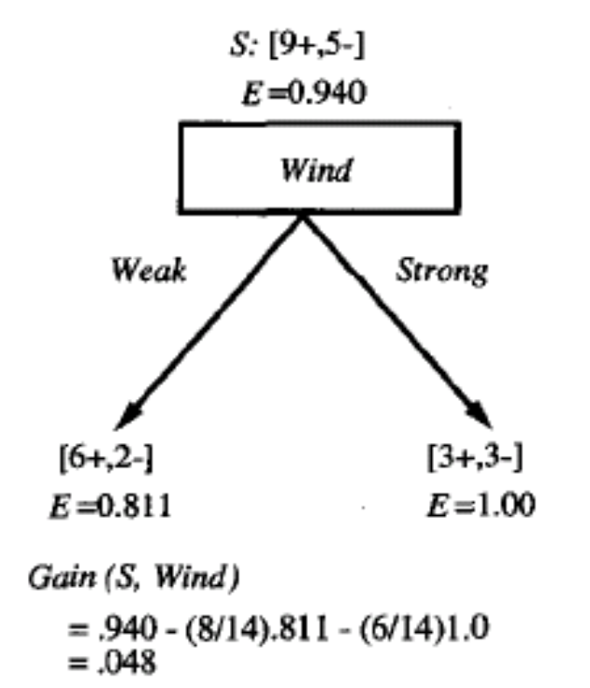
DECISION TREES
Which Attribute is the Best Classifier?: Information Gain
We calculate the Info Gain for each attribute and select the attribute having the highest Info Gain

Slide 31
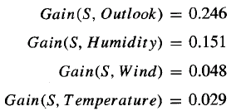
DECISION TREES
Example
Which attribute should be selected as the first test?
“Outlook” provides the most information

Slide 32
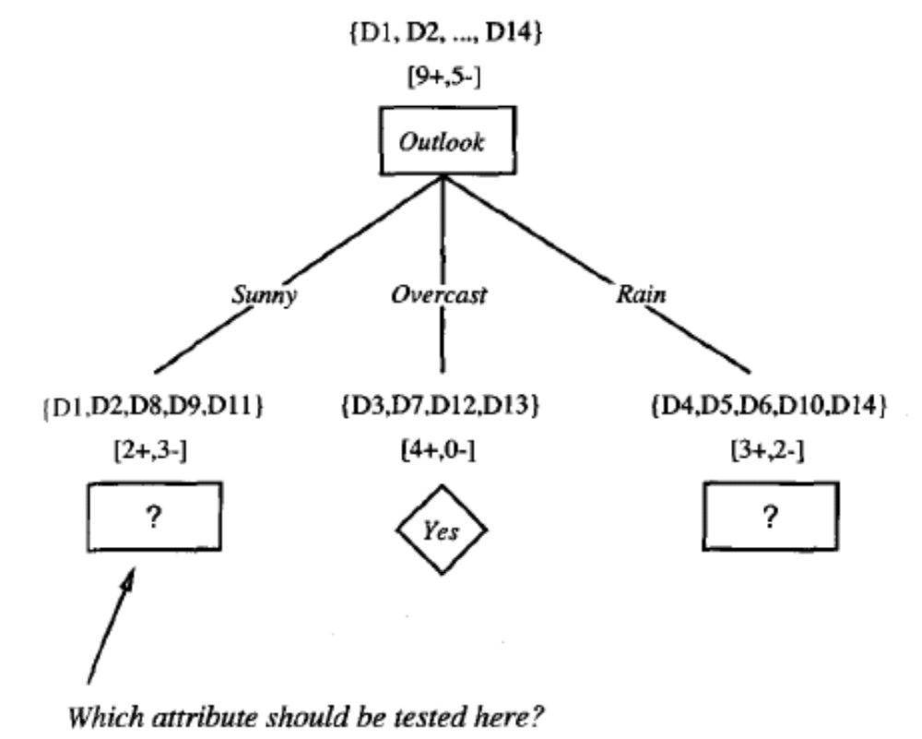
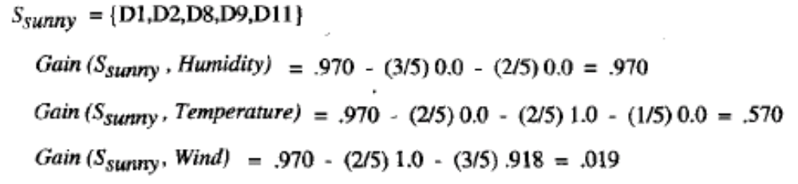
DECISION TREES

Slide 33
DECISION TREES
Example
The process of selecting a new attribute is now repeated for each (non-terminal) descendant node, this time using only training examples associated with that node
Attributes that have been incorporated higher in the tree are excluded, so that any given attribute can appear at most once along any path through the tree

Slide 34
DECISION TREES
Example
This process continues for each new leaf node until either:
Every attribute has already been included along this path through the tree
The training examples associated with a leaf node have zero entropy

Slide 35
DECISION TREES
Example

Slide 36
DECISION TREES
From Decision Trees to Rules
Next Step: Make rules from the decision tree
After making the decision tree, we trace each path from the root node to leaf node, recording the test outcomes as antecedents and the leaf node classification as the consequent
For our example we have:
If the Outlook is Sunny and the Humidity is High then No
If the Outlook is Sunny and the Humidity is Normal then Yes
...

Slide 37
DECISION TREES
Reference
Sections 3.1 – 3.4 of T. Mitchell
Section 4.3 of Witten & Frank

